Slide 1
Lie With Data
Hemin Patel

Slide 2
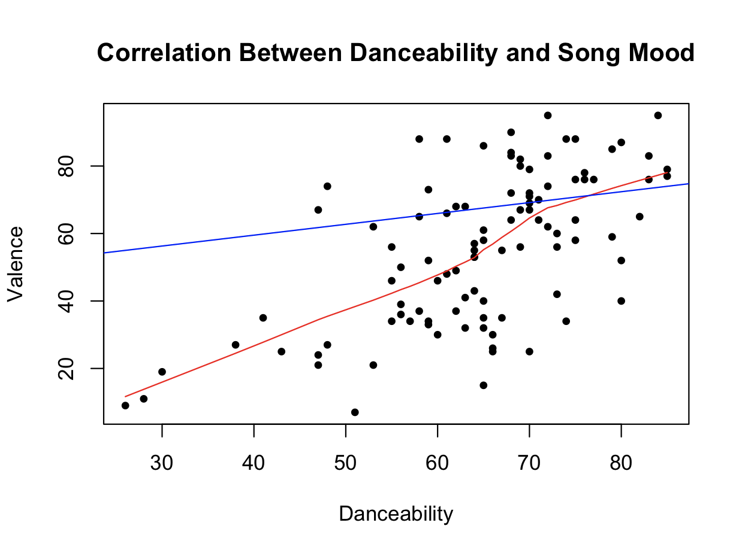
My Misleading Data Set
For this chart, I used the data from my first project.
In this graph, the y-axis starts at 20, which is misleading, as it should start at 0. Moreover, the data is incorrect: the data points are accurate; however, the y-axis is incorrect, as it was tampered with and entails that Valence affects danceability more than it does.

Slide 3
My Real Data Set
For this chart, I used the data from my first project.
This is the real graph, and you can tell this one is not misleading as the y-axis is not tampered with and does not start at 20 and starts at 0, even though it isn’t displayed.

Slide 4
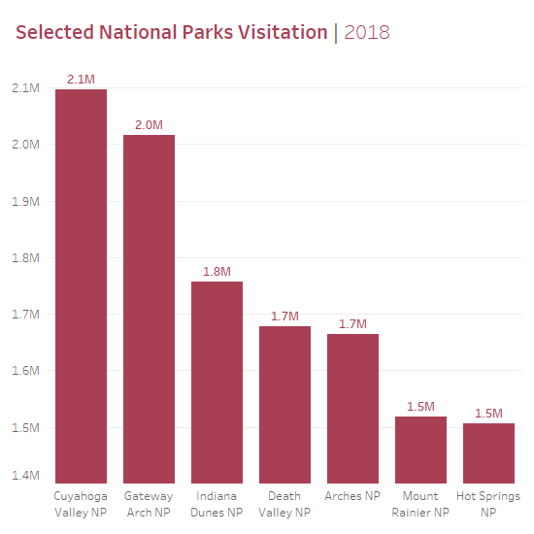
Real-Life Example
This graph is misleading as the y-axis begins as 1.4M rather than 0.
The graph makes it seem that Cuyahoga Valley and Gateway Arch receive more visitors than the others
It is apparent that the chart was tampered with as the gap between 1.8M and 2.0M is larger than that of 1.5M and 1.8M
The goal of this graph is to represent that Cuyahoga Valley and Gateway Arch receive more visitors.
In reality, there should not be significant gaps between the parks listed on the x-axis.

